Slide 1
Building a Yellow Brick Road Towards A Cure
Michael Louella

Slide 2
Disclosure
Relations that could be relevant for the meeting | Company names
Sponsorship or refund funds | none
Payment or other financial remuneration | none
Shareholder rights | none
Other relations | none

Slide 3
WHY A YELLOW BRICK ROAD?
Notes:
I dream about a cure for HIV.
The yellow brick road is probably one of the most famous metaphors in the English language.
Symbolically it represents a course of action that a person takes believing that it will lead to good things.
It comes from the Yellow Brick Road in The Wizard of Oz which Dorothy and her friends follow to the Emerald City.
Most of us see it as a symbol of the journey of life that everyone has to take, filled with thrills and dangers and holding the promise of something wonderful at journey's end.

Slide 4
FORM INTO GROUPS
EACH AISLE WILL BECOME A GROUP
2. EACH GROUP HAS AN APPOINTED LEADER
3. LOOK FOR YOUR GROUP LEADER & GATHER AROUND THEM

Slide 5
BRAINSTORM, WRITE DOWN & RANK
1. COLLECT IDEAS FROM THE GROUP – QUICKLY!
2. HAVE GROUP DECIDE WHAT ARE THEIR
TOP 5 ANSWERS
3. THEN HAVE GROUP RANK THEM
(most important to least)

Slide 6
WHAT QUALITIES SHOULD AN IDEAL HIV CURE HAVE?

Slide 7
WHAT QUALITIES SHOULD AN IDEAL HIV CURE HAVE?
“An ideal HIV cure should
be____.”
“An ideal HIV cure should
do _____.”
“An ideal HIV cure should
have ______. ”

Slide 8
HIV
CURE
?

Slide 9
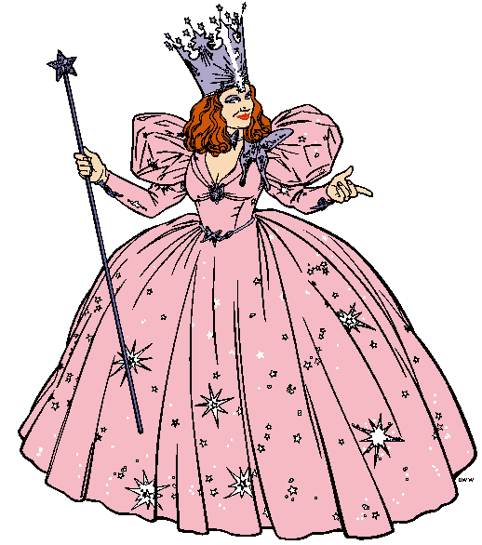
HIV
CURE
SAFE

Slide 10
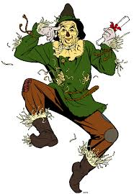
HIV
CURE
?
EFFECTIVE

Slide 11
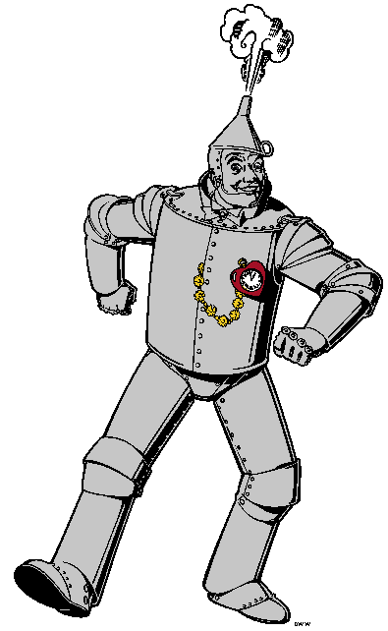
HIV
CURE

Slide 12
HIV
CURE
AFFORDABLE
?

Slide 13
HIV
CURE
ACCESSIBLE
?

Slide 14
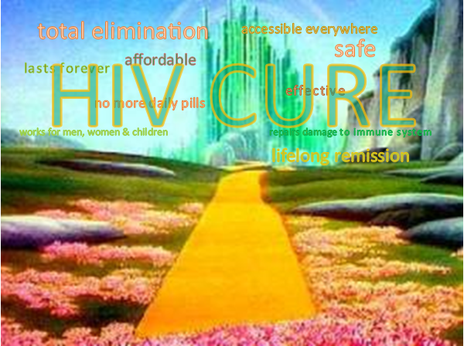
Notes:
hold these ideas in their minds as you experience the rest of the workshop
every presentation and discussion will in some way be touching on these qualities
point out how challenging these qualities will be for science to achieve

Slide 15
Notes:
HIV is a journey, not a war
We are building a road towards an HIV cure together
Community can facilitate HIV cure research by providing advice about the design and implementation of research protocols
Advocate for cure in their own communities, discuss the social meaning, ethical considerations, and economic consequences of HIV cure research with others
Be a knowledgeable cure ally

Slide 16
Notes:
Dream the impossible dream.

